Slide 1
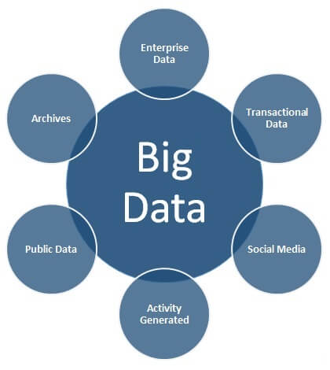
UNIT I : Sources of Big Data
SESSION : 02
TOPIC : Sources of Big Data
Industry/Tech: Analog Devices, Database Registers
Problem statement:
Sources of big data

Slide 2
UNIT I : Sources of Big Data
SESSION : 01
TOPIC : Sources of Big Data
Industry/Tech: Analog Devices, Database Registers
Problem statement: Sources of big data
Enterprise Data | Common formats include flat files, emails, Word documents, spreadsheets, presentations, HTML pages/documents, pdf documents, XMLs, legacy formats, etc
Transactional Data | Web Applications, Mobile Applications, CRM Systems, and many more.
Social Media | social networks like Twitter, Facebook, etc. The social networks usually involve mostly unstructured data formats which includes text, images, audio, videos, etc.
Activity Generated | There is a large amount of data, hese include data from medical devices, censor data, surveillance videos, satellites, cell phone towers, industrial machinery, and other data generated mostly by machines.
Public Data | publicly available like data published by governments, research data published by research institutes, data from weather and meteorological departments, census data, Wikipedia, sample open source data feeds
Archives | which is either not required anymore or is very rarely required, Its includes scanned documents, scanned copies of agreements, records of ex-employees/completed projects, banking transactions older than the compliance regulations

Slide 3
UNIT I : Introduction to Big Data
SESSION : 01
TOPIC : Introduction to Big Data
Industry/Tech: Analog Devices, Database Registers
Sources of big data

Slide 4
UNIT I : Sources of Big Data
SESSION : 01
TOPIC : Sources of Big Data
Industry/Tech: Analog Devices, Database Registers
Problem statement: Sources of big data
Media as a big data source | Media includes social media and interactive platforms, like Google, Facebook, Twitter, YouTube, Instagram, as well as generic media like images, videos, audios, and podcasts that provide quantitative and qualitative insights on every aspect of user interaction.
Cloud as a big data source | Cloud storage accommodates structured and unstructured data and provides business with real-time information and on-demand insights.
The web as a big data source | Data on the Web or ‘Internet’ is commonly available to individuals and companies alike
IoT as a big data source | IoT is now gaining momentum and includes big data generated, not only from computers and smartphones, but also possibly from every device that can emit data. With IoT, data can now be sourced from medical devices, vehicular processes, video games, meters, cameras, household appliances, and the like
Databases as a big data source | These databases can then provide for the extraction of insights that are used to drive business profits. Popular databases include a variety of data sources, such as MS Access, DB2, Oracle, SQL, and Amazon Simple, among others.

Slide 5
UNIT I : Introduction to Big Data
SESSION : 01
TOPIC : Introduction to Big Data
Industry/Tech: Analog Devices, Database Registers
Sources of big data:
Media as a big data source
Cloud as a big data source
The web as a big data source
IoT as a big data source
Databases as a big data source

Slide 6
UNIT I : Introduction to Big Data
SESSION : 01
TOPIC : Introduction to Big Data
Industry/Tech: Analog Devices, Database Registers
Objective:
The basic knowledge of Big data.
Outcome:
Students are learnt about the Sources of big data
.

